Slide 1


English communication skills
Group 18
The vanguard
Presentation

Slide 2
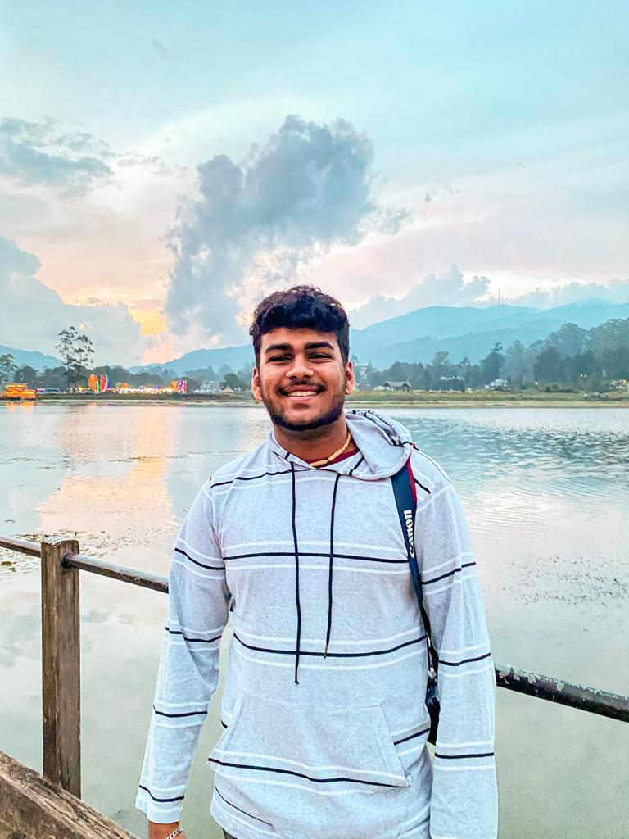
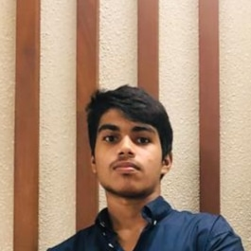
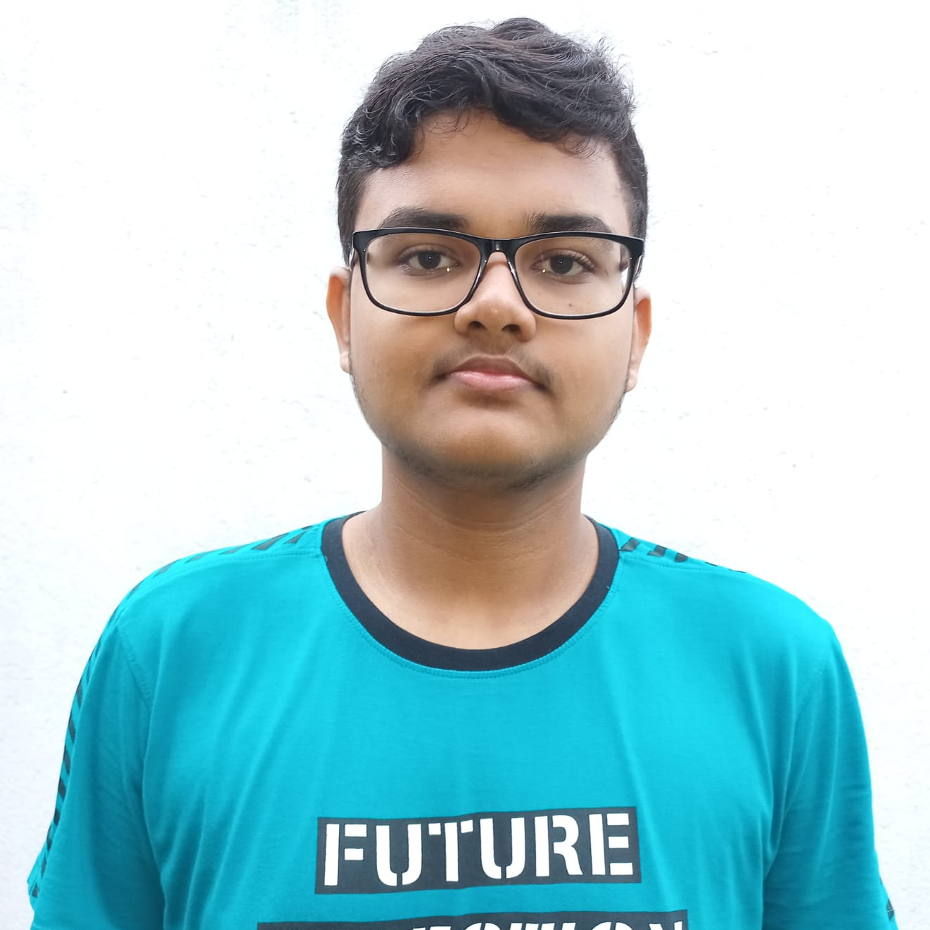
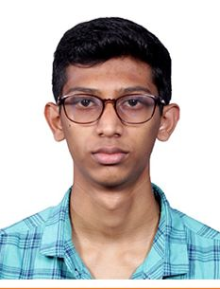
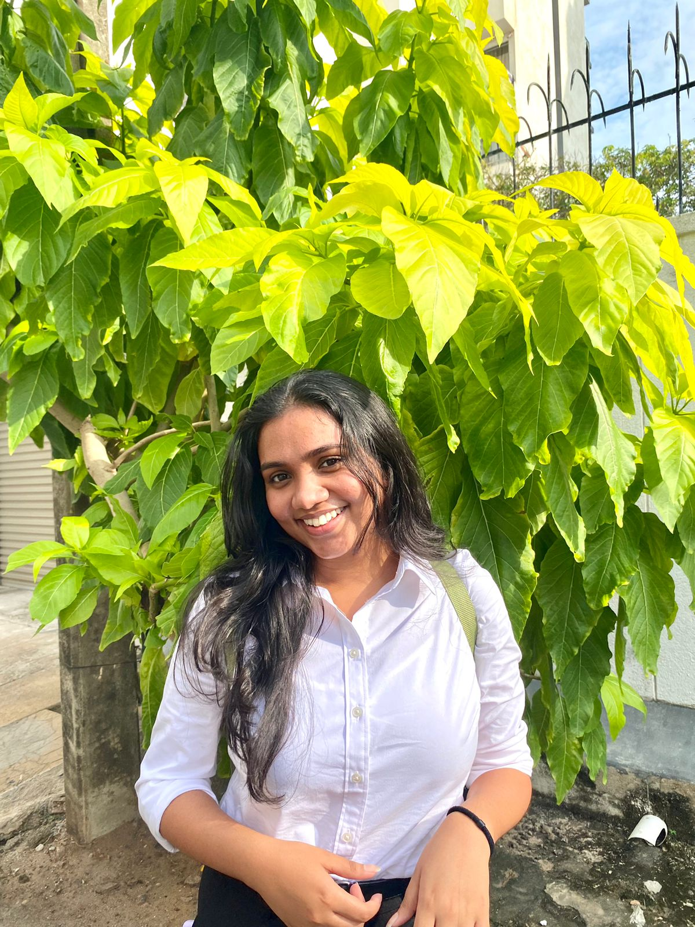
Team Members
English communication skills
Group 18
The vanguard
Presentation

Slide 3

Team Members
Group 18
The vanguard
Presentation
English communication skills
20220794
Disandu Perera
20220801
Banusha Kalhara
20220799
Amika Deshapriya
20220802
Oshani Jayawardena
20220792
Malith Tissera

Slide 4

Topics

Slide 5
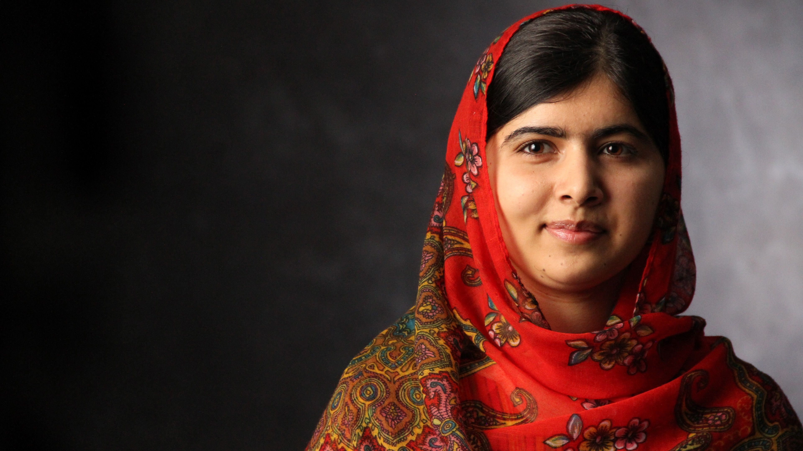







Malala Yousafzai
Pakistani education activist
Notes:
https://unsplash.com/photos/AXu2aZ3YgP8

Slide 6

Introduction

Slide 7
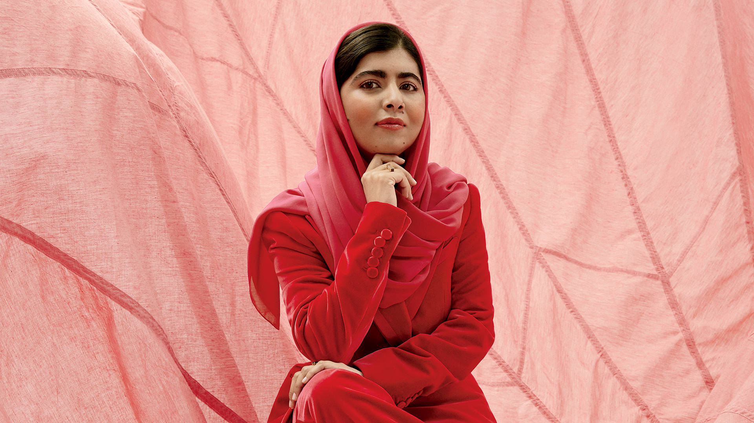

Slide 8
Introduction

Slide 9
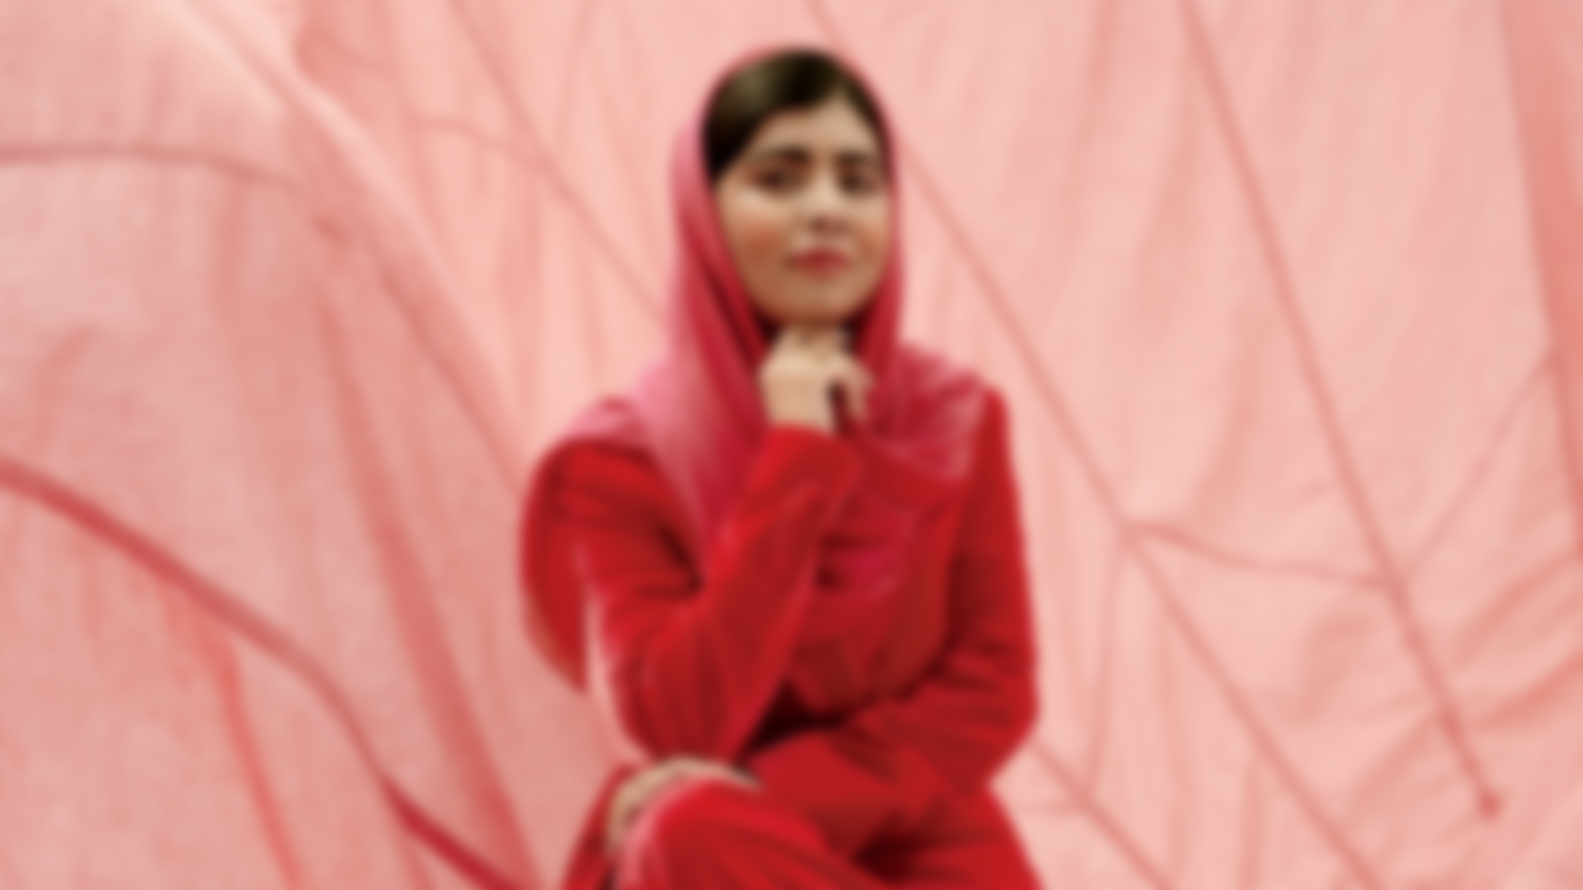
Introduction
Born in 1997, Malala Yousafzai defied the Taliban for girls' education, surviving a shooting at 15. A symbol of resilience, her story underscores the ongoing importance of her global mission

Slide 10
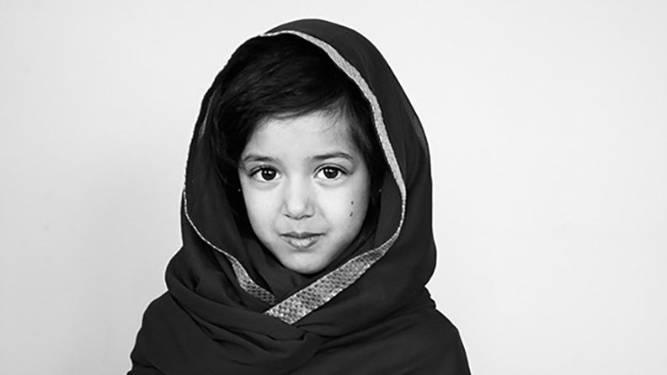

History
The daughter of an outspoken social activist and educator.
After the invasion The TTP Began destroying girls’ schools banning women from education.
She gave a speech—“How Dare the Taliban Take Away My Basic Right to Education?

Slide 11
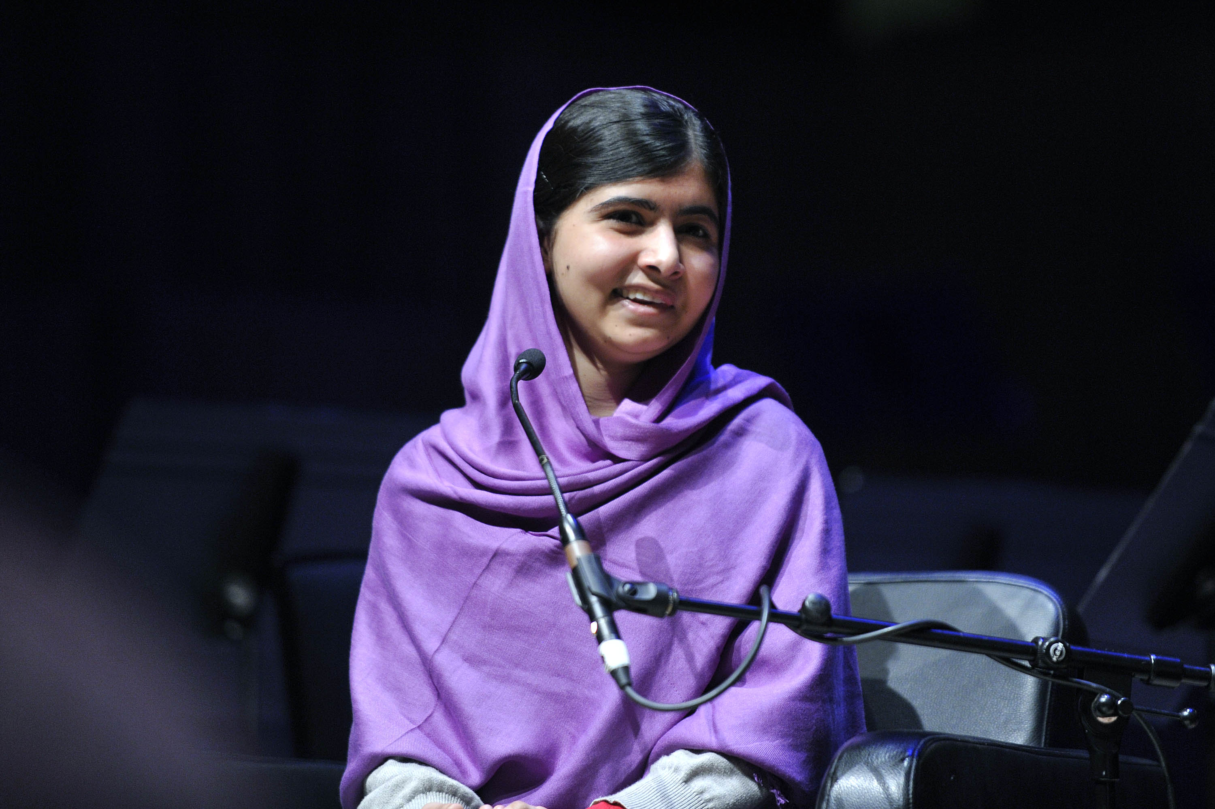

History
The daughter of an outspoken social activist and educator.
After the invasion The TTP Began destroying girls’ schools banning women from education.
She gave a speech—“How Dare the Taliban Take Away My Basic Right to Education?
She began writing for BBC Urdu about her daily life influenced by the TTP
She was nominated for the International Children’s Peace Prize.
She was awarded Pakistan’s first National Youth Peace Prize
Notes:
https://unsplash.com/photos/GKLIsLZxhj0

Slide 12
The daughter of an outspoken social activist and educator.
After the invasion The TTP Began destroying girls’ schools banning women from education.
She gave a speech—“How Dare the Taliban Take Away My Basic Right to Education?
History
She began writing for BBC Urdu about her daily life influenced by the TTP
She was nominated for the International Children’s Peace Prize.
She was awarded Pakistan’s first National Youth Peace Prize
Notes:
https://unsplash.com/photos/GKLIsLZxhj0

Slide 13

Famous for
Advocacy to Education
Malala is a steadfast supporter of girls' rights to education, especially in situations where many people around the world have been denied this privilege.
Empowerment of Young People
Young people around the world are supported and encouraged to stand up and fight for their rights by Malala

Slide 14
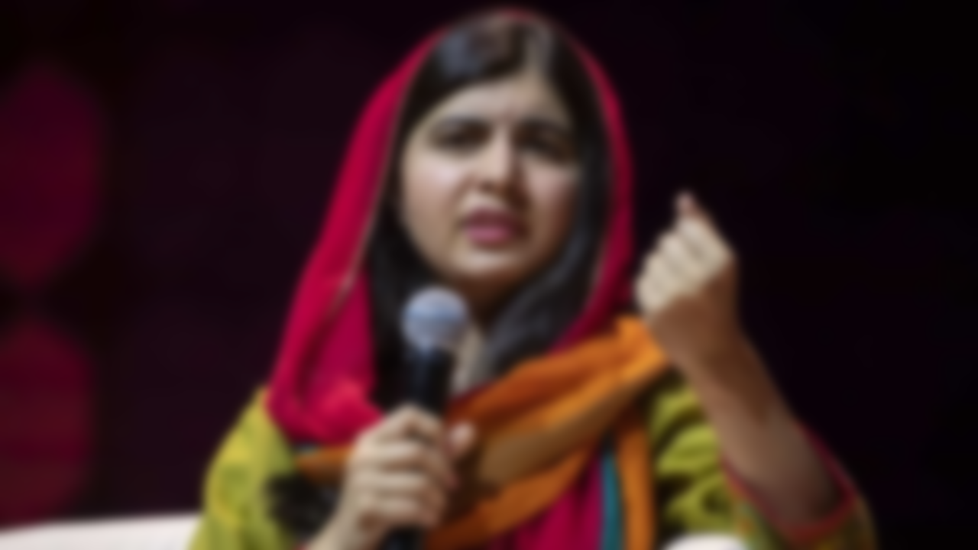
Educational Initiatives
Through Malala Fund, educational opportunities to girls were provided in regions with limited resources.
Bravery and Resilience
Malala’s courage in facing extreme threats by Taliban and continuing to speak out despite the risks was an act of immense bravery.
Famous for
Why is she a role model
Advocacy to Education
Malala is a steadfast supporter of girls' rights to education, especially in situations where many people around the world have been denied this privilege.
Empowerment of Young People
Young people around the world are supported and encouraged to stand up and fight for their rights by Malala
Notes:
https://unsplash.com/photos/48nerZQCHgo

Slide 15
Famous for
Why is she a role model
Educational Initiatives
Through Malala Fund, educational opportunities to girls were provided in regions with limited resources.
Bravery and Resilience
Malala’s courage in facing extreme threats by Taliban and continuing to speak out despite the risks was an act of immense bravery.
Advocacy to Education
Malala is a steadfast supporter of girls' rights to education, especially in situations where many people around the world have been denied this privilege.
Empowerment of Young People
Young people around the world are supported and encouraged to stand up and fight for their rights by Malala
Notes:
https://unsplash.com/photos/48nerZQCHgo

Slide 16
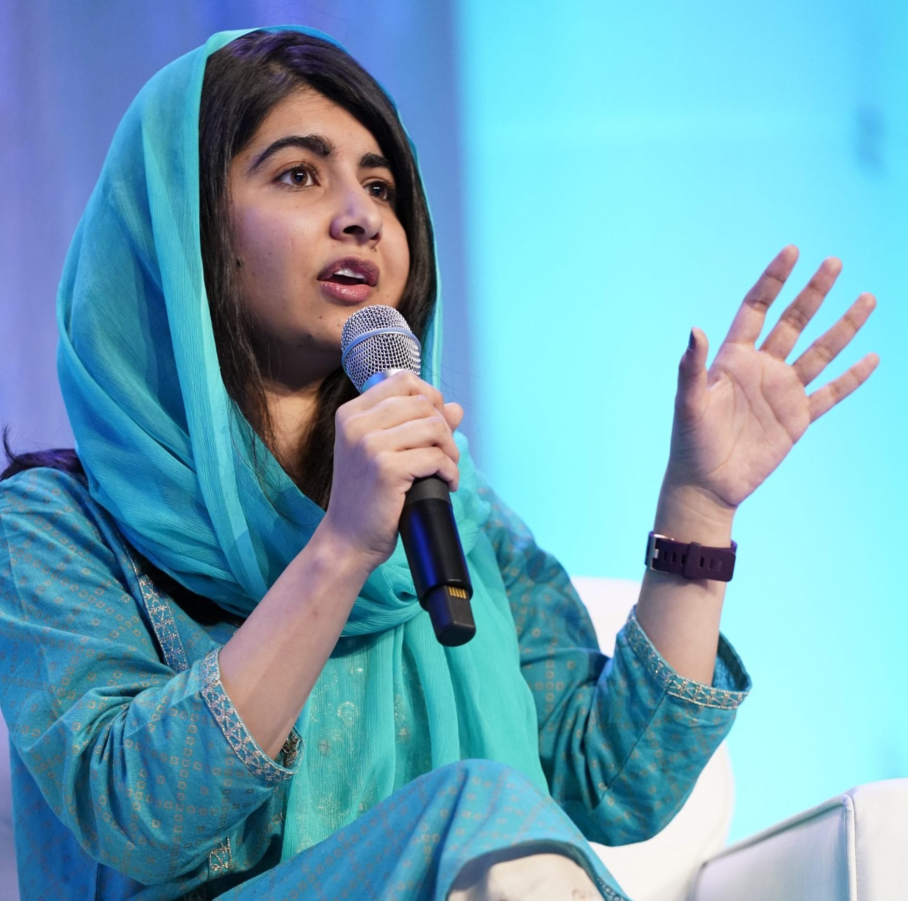

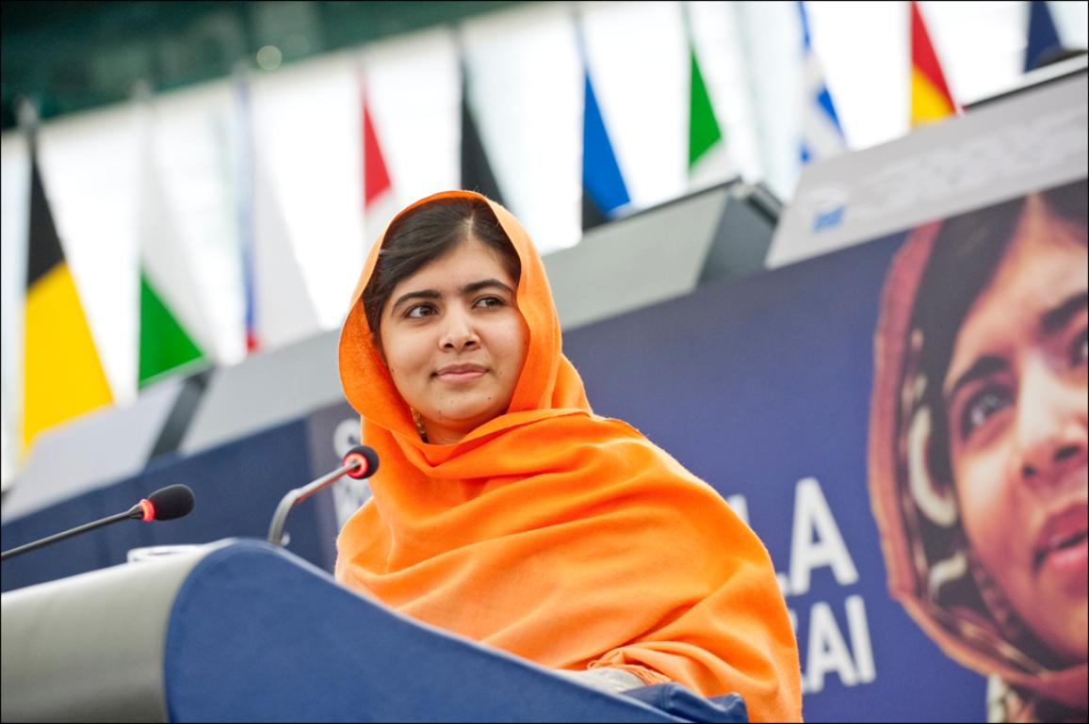
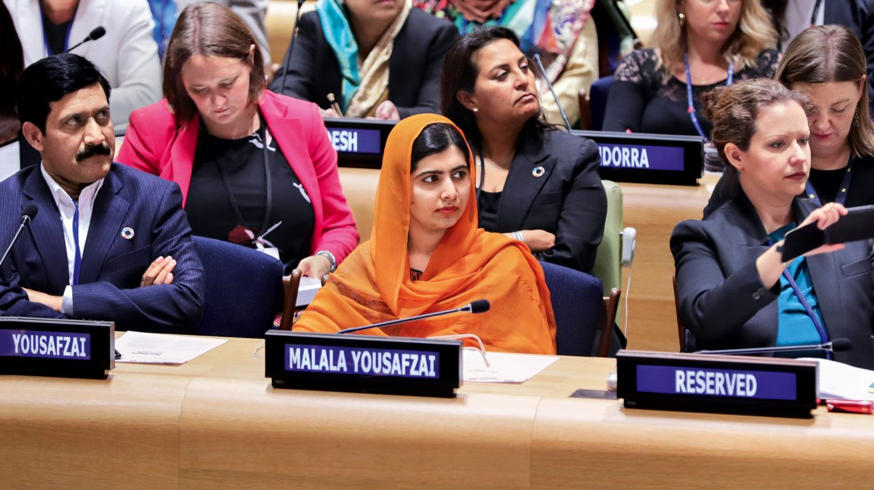
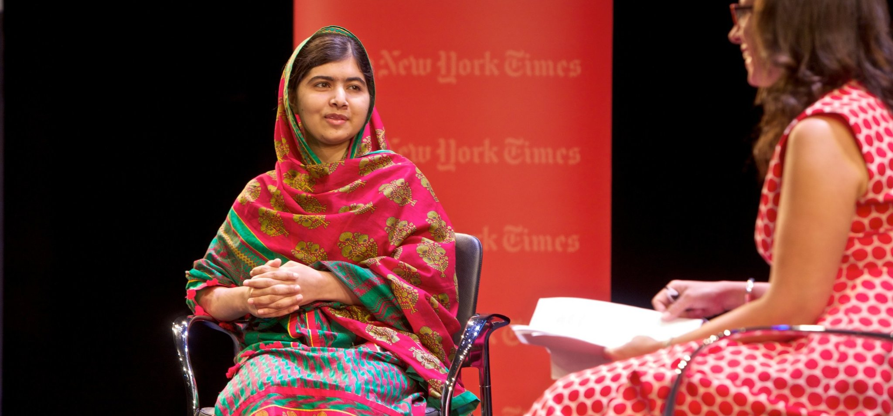
Social acts
Struggle for the right of the all children to education
Started Malala Fund to advocating for girls’ education globally
Won Nobel peace price in 2014
Published her own autobiography

Slide 17
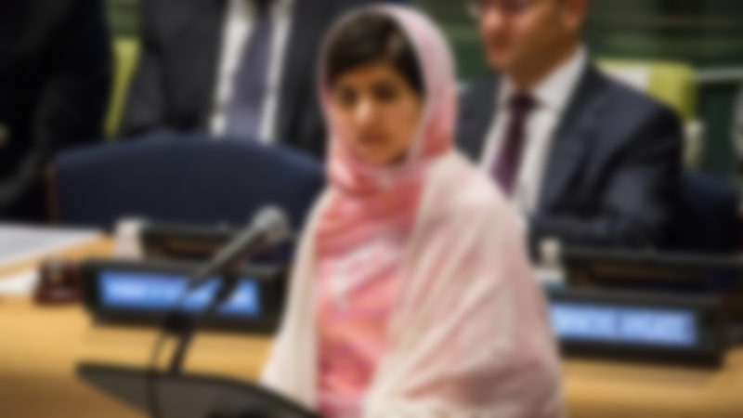
Social acts
Struggle for the right of all children to education
Started Malala Fund to advocating for girls’ education globally
Won Nobel peace price in 2014.
Published her own autobiography.
Notes:
https://unsplash.com/photos/TvN54bnuQg8

Slide 18
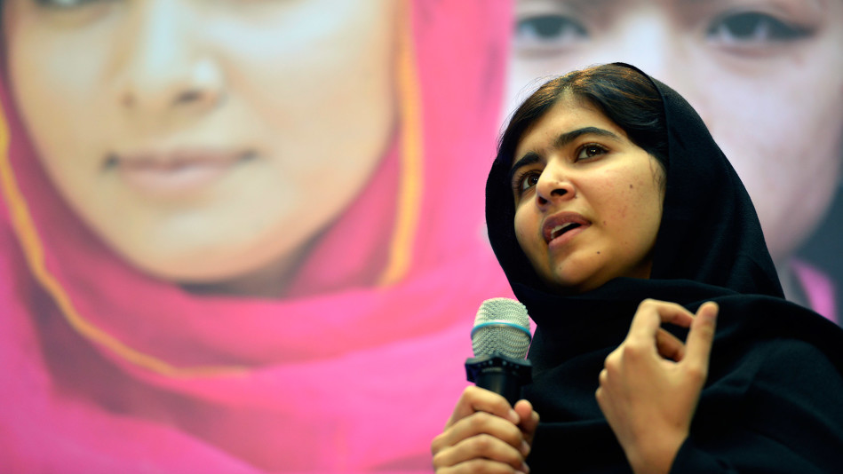

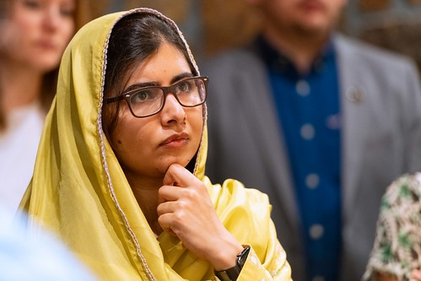
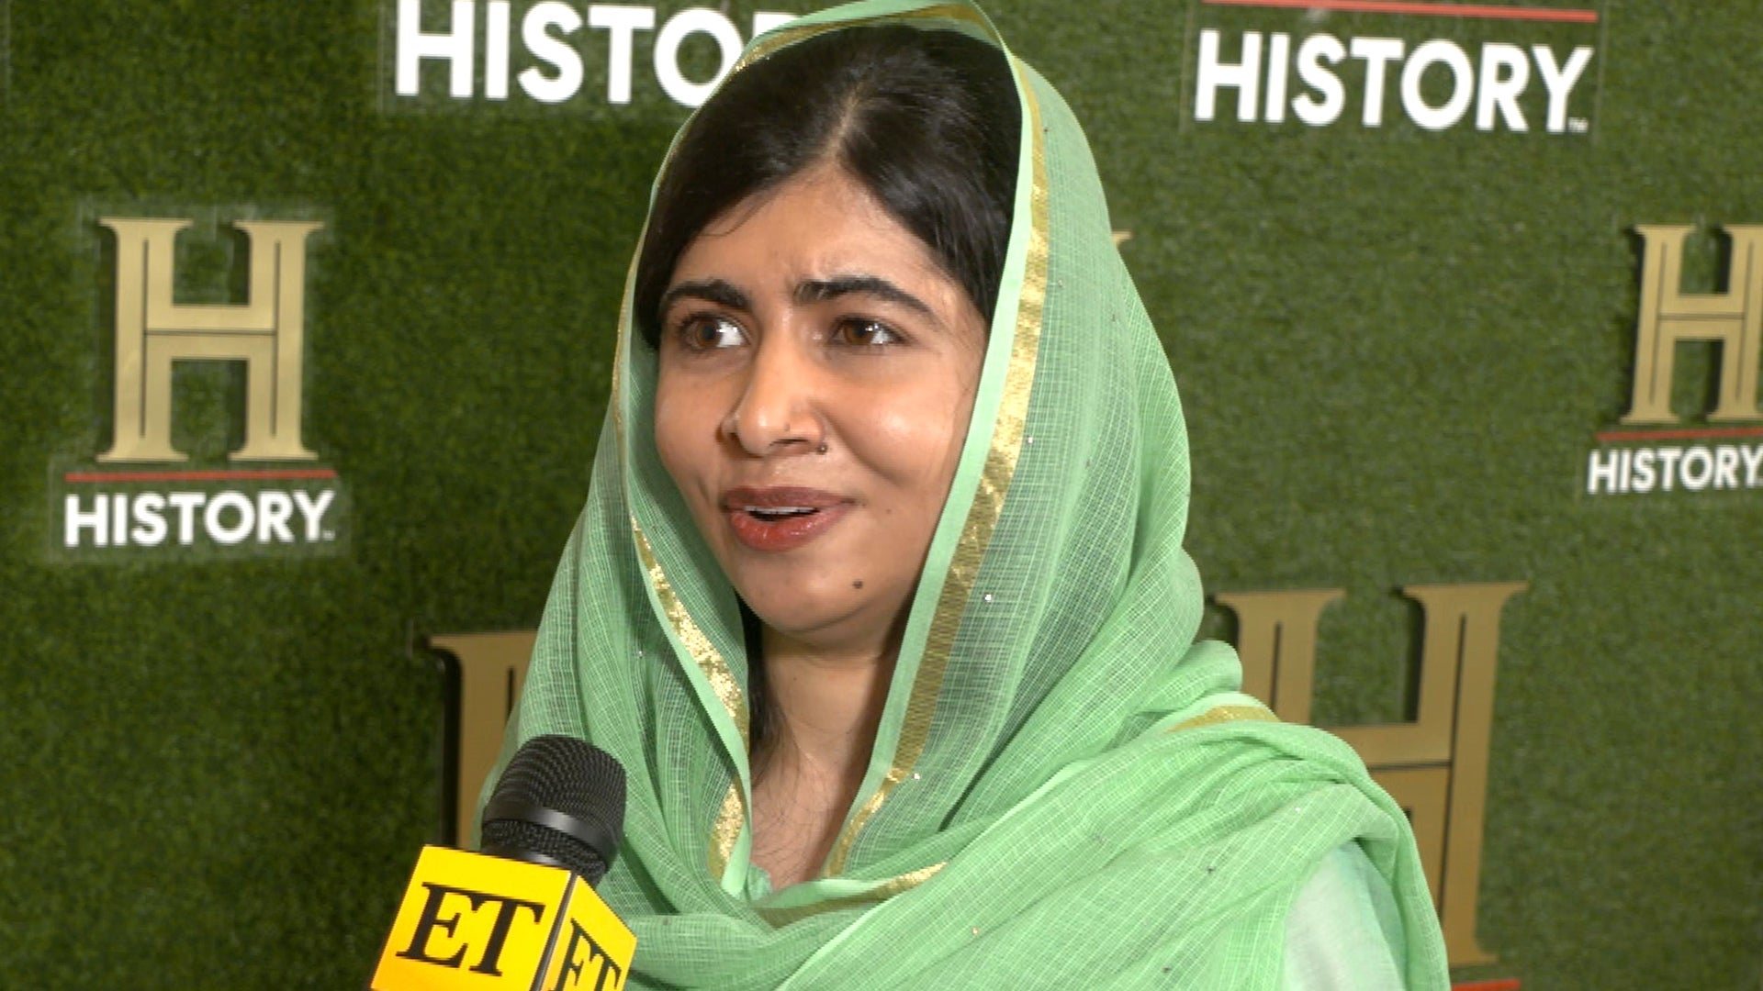
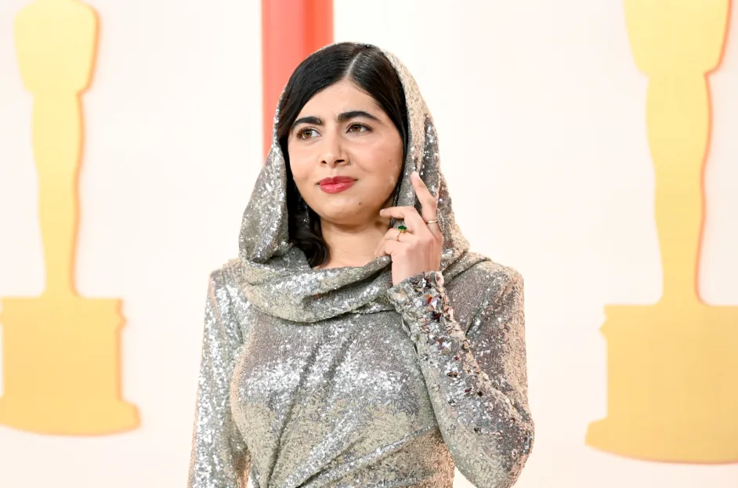
Conclusion
“When the world is silent, even one voice becomes powerful”

Slide 19

Conclusion
“When the world is silent, even one voice becomes powerful”
Malala Yousafzai
Notes:
https://unsplash.com/photos/TvN54bnuQg8

Slide 20

Reference
Malala Yousafzai (2023) Wikipedia. Available at: https://en.wikipedia.org/wiki/Malala_Yousafzai (Accessed: 17 November 2023).
Malala’s story (no date) Malala Fund. Available at: https://malala.org/malalas-story (Accessed: 17 November 2023).
The nobel peace prize 2014 (no date) NobelPrize.org. Available at: https://www.nobelprize.org/prizes/peace/2014/yousafzai/biographical/ (Accessed: 17 November 2023).
Malala Yousafzai (2023a) Encyclopædia Britannica. Available at: https://www.britannica.com/biography/Malala-Yousafzai (Accessed: 17 November 2023).

Slide 21
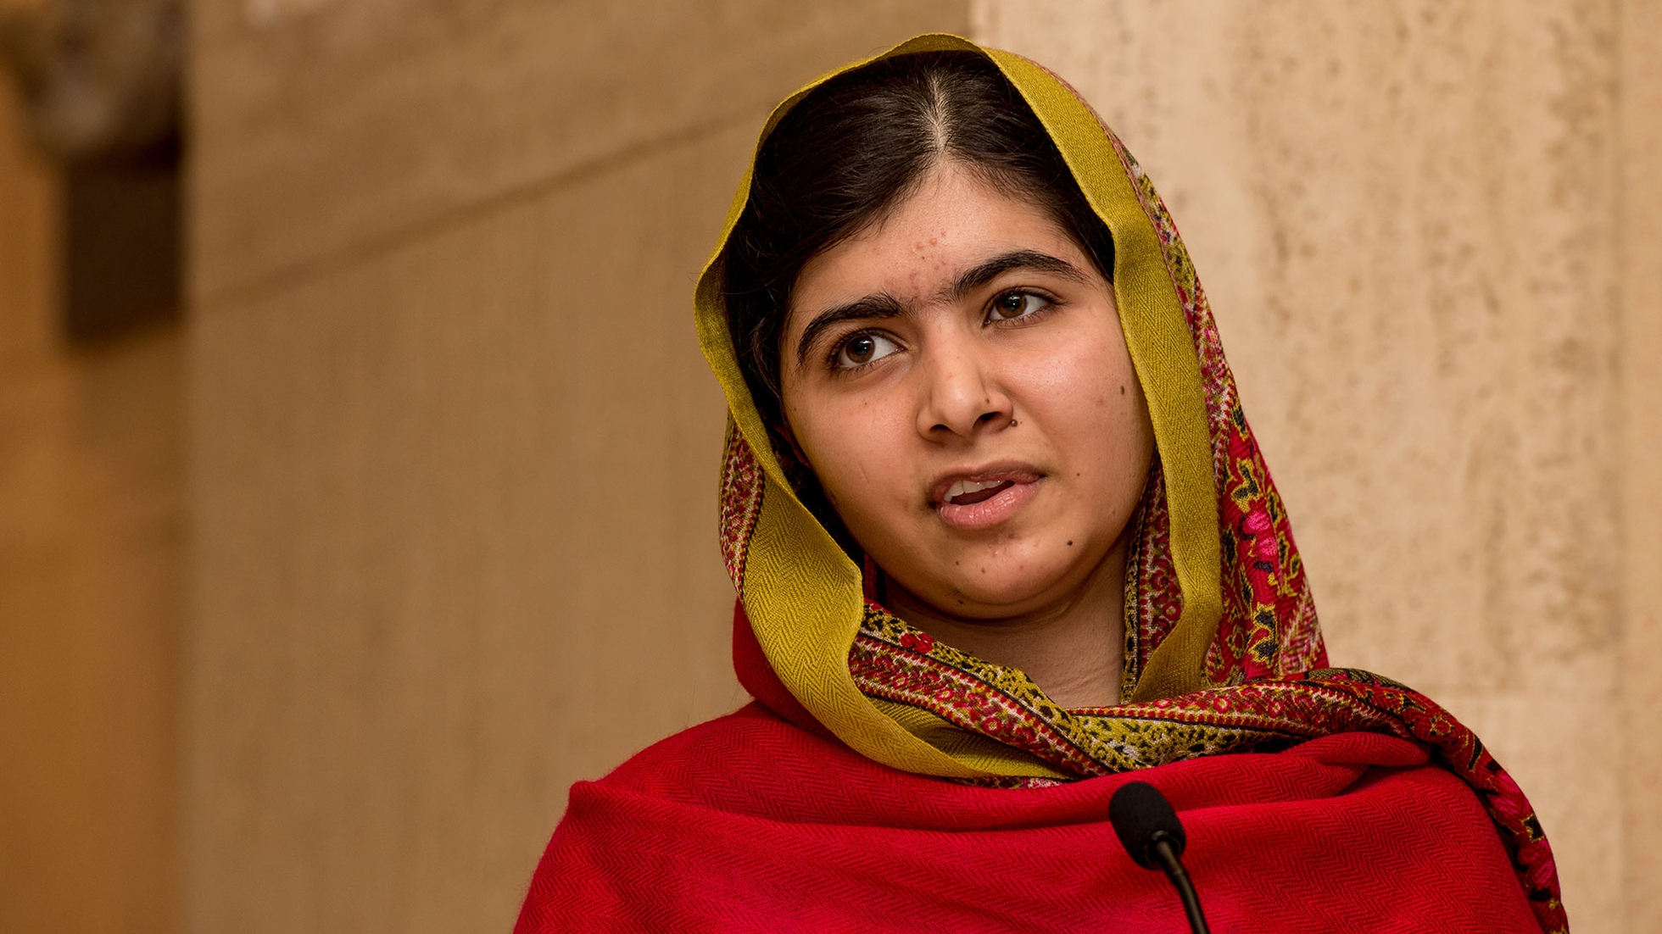

Reference
Malala Yousafzai (2023) Wikipedia. [online] Available at: https://en.wikipedia.org/wiki/Malala_Yousafzai (Accessed: 17 November 2023).
Malala’s story (no date) Malala Fund. [online] Available at: https://malala.org/malalas-story (Accessed: 17 November 2023).
The Nobel peace prize 2014 (no date) NobelPrize.org. [online] Available at: https://www.nobelprize.org/prizes/peace/2014/yousafzai/biographical/ (Accessed: 17 November 2023).
Malala Yousafzai (2023a) Encyclopædia Britannica. Available at: https://www.britannica.com/biography/Malala-Yousafzai (Accessed: 17 November 2023).
Notes:
https://unsplash.com/photos/TvN54bnuQg8

Slide 22
Team Contributions

Slide 23
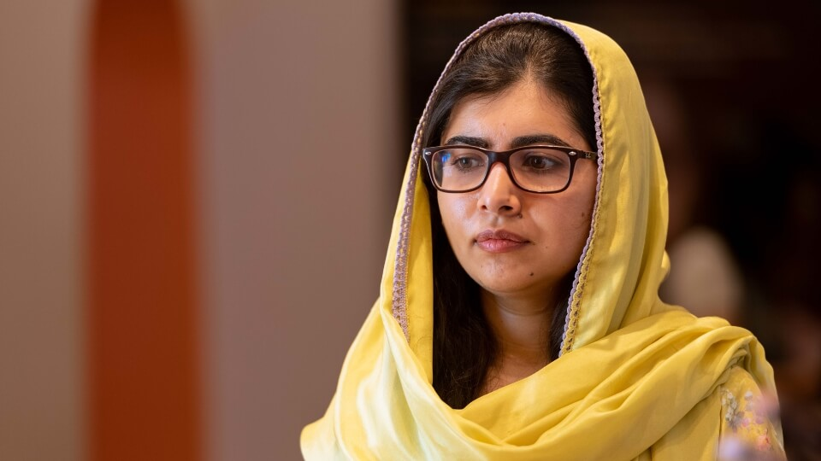
Team Contributions
20220794
Disandu Perera
(Team Leader)
Research about history of Malala Youzafsai
Research about Malala Youzafsai ‘s life
20220799
Amika Deshapriya
Creating and designing slides
Research about Malala Youzafsai
20220801
Banusha Kalhara
20220792
Malith Tissera
Research about Malala Youzafsai ‘s
Social acts
Research about Malala Youzafsai
20220802
Oshani Jayawardena
Notes:
https://unsplash.com/photos/TvN54bnuQg8

